Slide 1




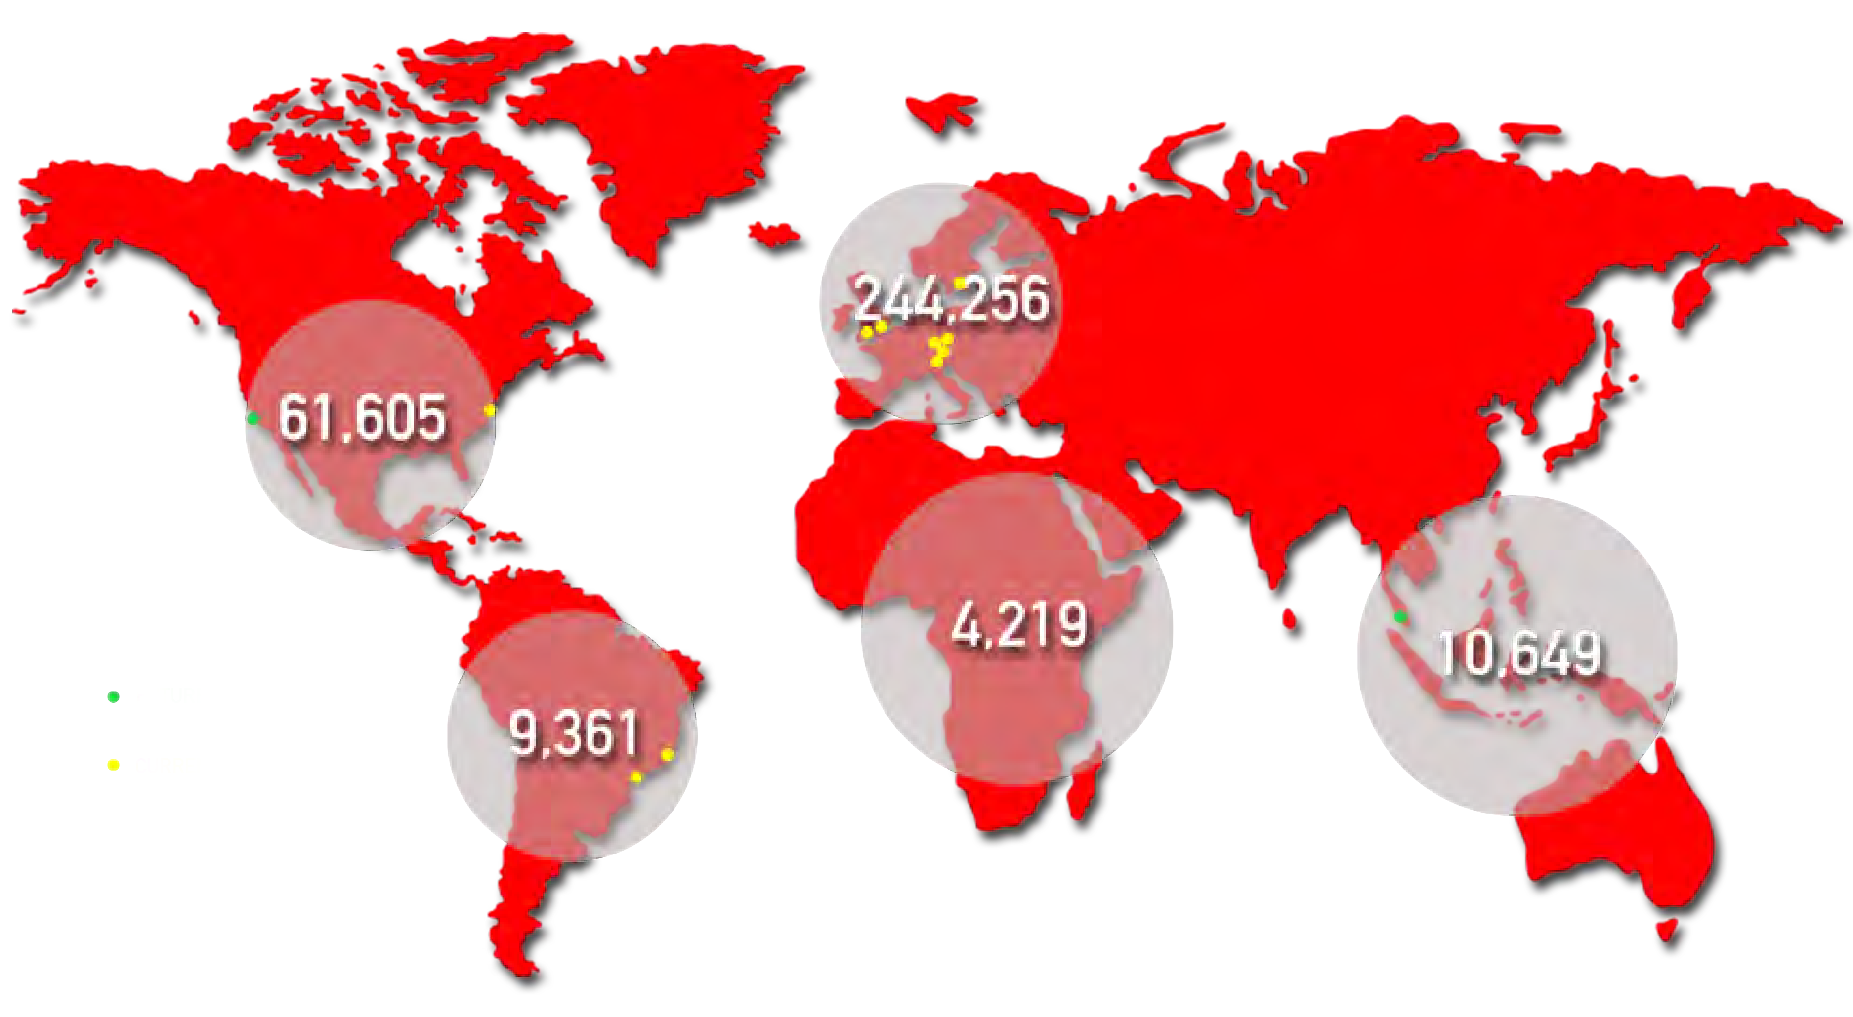

THE GLOBAL SAP SOLUTIONS PROVIDER
RED is a Global SAP Solutions Provider dedicated to helping organisations do one thing – leverage SAP investment to unlock competitive advantage.
SAP Network
From SAP Staffing to SAP Consulting, we can support every phase of the SAP Application Lifecycle in both the cloud and on-premise.
Our suite of SAP services is united by one thing:
Access to the best and most experienced SAP professionals in the world. It’s what we like to call the RED Difference. It’s what makes us the trusted SAP partner to 1000s of growing businesses across the world.
330,000 consultants in 172 countries
1200 SAP Projects Supported
600 Consultants working on SAP Projects
1,600 + SAP HANA Consultants

Slide 2

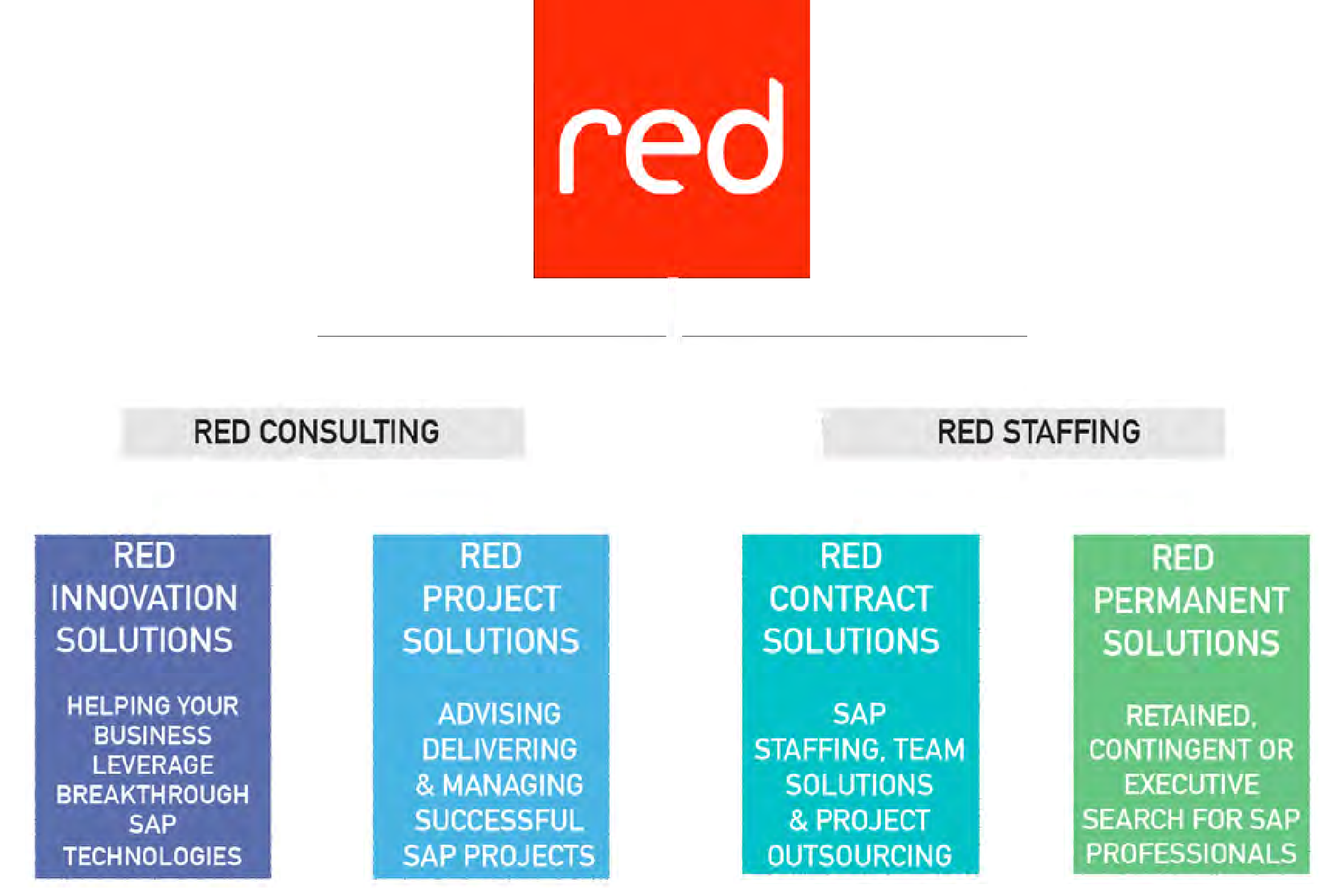
















































RED OVERVIEW
KEY FACTS
Established in 1999
Exclusively SAP
• £90mil in 2013
250 Employees
9 offices across UK, Germany, Switzerland, Sweden, USA and Brazil
SAP Services Partner in UK & US
Over 330,000 dedicated SAP associates globally
Preferred third party supplier to SAP across EMEA, A-PAC and Brazil
GLOBAL CUSTOMERS
RED has placed SAP consultants into SAP on every continent this year!
UK
120 UK based staff in two offices
60,000 strong UK & Ireland SAP experts in our network
500 UK clients
2 UK customer SAP HANA events run with CISCO and SAP attracting 60 attendees each
MARKET INTELLIGENCE
1,600 SAP Professionals spoken to daily
30,000 Unique website vistors per month
200,000 Emails sent quarterly
1 Global and 5 country specific market surveys per year
376k first tier SAP social connections
Click here to watch our exclusive ‘Hayman on HANA’ video series, featuring SAP Mentor Owen Pettiford & Les Hayman, Non-Executive
Director at RED & Former Board Member SAP-AG

Slide 3


